Slide 1

Major Project
Health Care System
(G-248)

Slide 2
Team Members
Vishnukant Shukla (A-71 / 2115001137)
Piyush Varshney (B-43 / 2115000710)
Prakhar Mittal (A-50 / 2115000732)
Harsh Sharma (G-24 / 2115000445)

Slide 3
Why do we need a health care system?
Long lines at reception
Long waits for lab results
High levels of medical appointment fees
Expansion of epidemic and viral diseases due to hospital overcrowding

Slide 4
Purpose of Health Care System:
Increase User Awareness
Disease Prediction
Doctor-Patient communication
Ease of Appointment

Slide 5
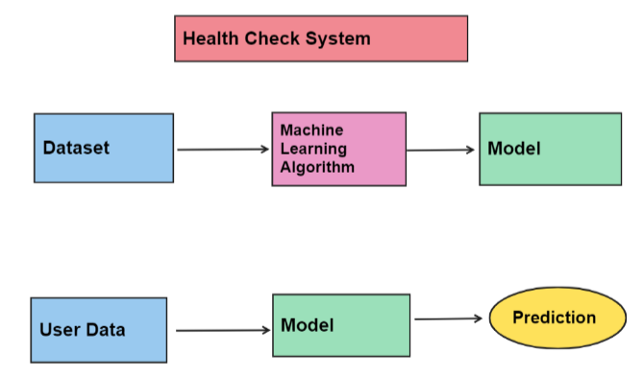
System Design

Slide 6
Machine Learning Algorithm
Decision Tree Classifier
KNN
SVM
Logistic Regression

Slide 7
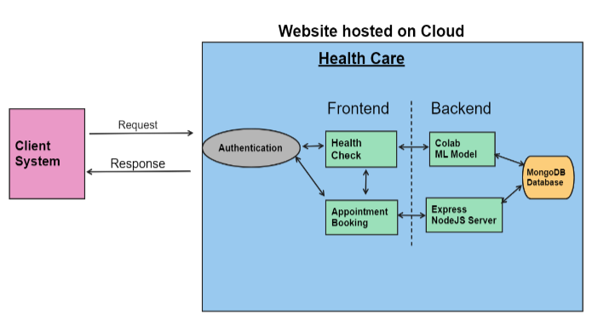

Slide 8
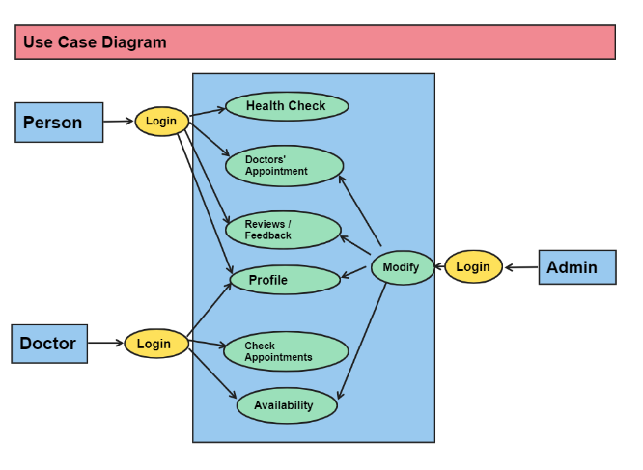

Slide 9
Reference Research Journals
Disease Prediction using Machine Learning Algorithms(https://ieeexplore.ieee.org/document/9154130)
Human Disease Prediction using Machine Learning Techniques and Real-life Parameters(https://www.ije.ir/article_169090_5525e34b7bd485c6f9f9cc710f62522f.pdf)
Disease Prediction From Various Symptoms Using Machine Learning(https://papers.ssrn.com/sol3/papers.cfm?abstract_id=3661426)

Slide 10
Thank You

